Slide 1
Tuition and Federal Aid: Preliminary Results
ECP4618 – Alex Keeney

Slide 2

Updated Hypothesis + Model
H₀: The amount of federal student and is not related to Tuition Cost at Top* US Universities.
H₁: The amount of federal student aid is positively related to cost of attendance at Top* US Universities.
Tuition Costs = $β_{0}$ + $β_{1}A$PGAF+ $β_{2}A$FSLAF + $β_{3}$CPI + $β_{4}$QCF + $β_{5}Apply$ + $β_{6}$ + $β_{7}$PS + $ε$
*In this context, ‘Top’ refers to the top 30 Universities in the US

Slide 3
Data: Creating the Data Frame
The Data came mostly from:
National Center for Education Statistics, Integrated Postsecondary Education Data System
US News and World Reports
The First year’s data was matched up manually
Ranks were matched with Tuition prices and Full Institution Name
Then, using Institution name as the join key, the same information was added for each of the 6 previous years.
Using several Python Left Merges
The resulting dataset now has 210 observations, all other variables were added
one final python Left Merge

Slide 4
Summary Statistics
Variables | List_Tuition | Rank | Private | CPI | Southern | Lag_APGAF “Avg. Pell Grants” | Lag_AFSLAF “Avg. Fed Loans” | Lag_Applicants
Mean | 39268.4619 | 14.9952 | 0.83333 | 231.3285714 | 0.2 | 4294.433333 | 5017.219048 | 29360.43333
Standard Deviation | 12839.49772 | 8.6569 | 0.3736 | 7.17165759 | 0.4009558 | 230.3550366 | 648.4307296 | 15086.68482
Median | 43431.5 | 15 | 1 | 233 | 0 | 4281.5 | 5001.5 | 27514
Minimum | 6665 | 1 | 0 | 218.1 | 0 | 3562 | 3516 | 4859
Maximum | 55056 | 30 | 1 | 240 | 1 | 4821 | 6686 | 97112

Slide 5
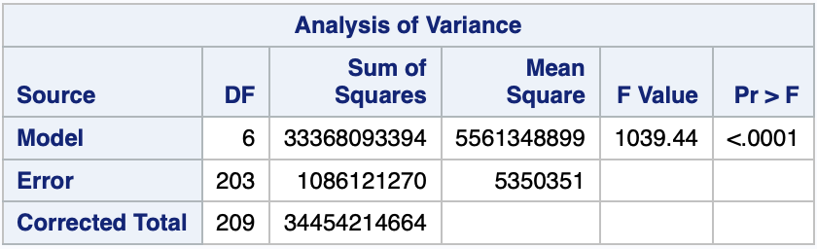
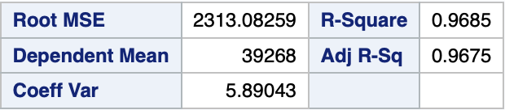
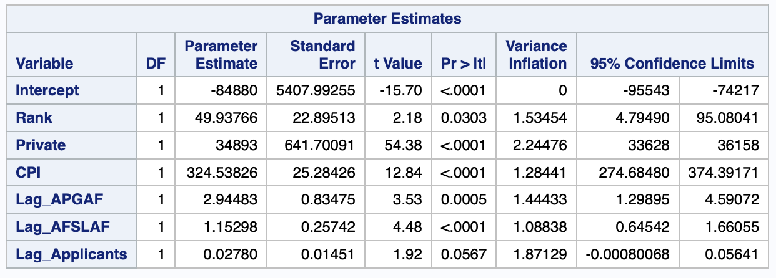
Regression Output

Slide 6
Regression Output: Diagnostics

Slide 7
Model problems
Not Nearly enough data
Dataset is lacking in both directions:
Not representative of all schools
Not long enough time frame.

Slide 8
Next steps
Get more data

